Slide 1
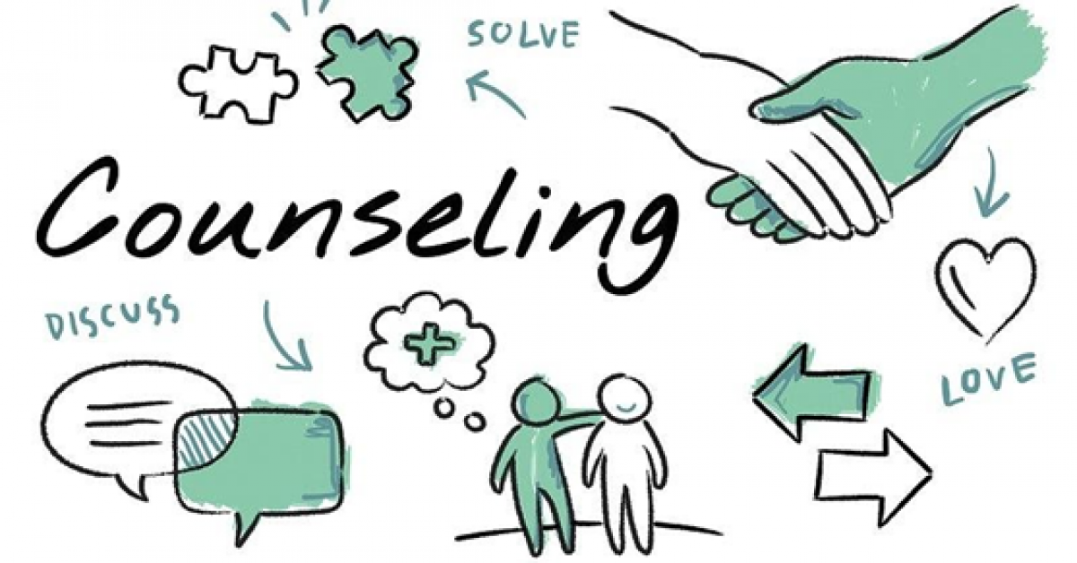
Skills
Ms. Shahtaj Shakir
Psychology lecturer
FAST NUCES University ,Karachi

Slide 2
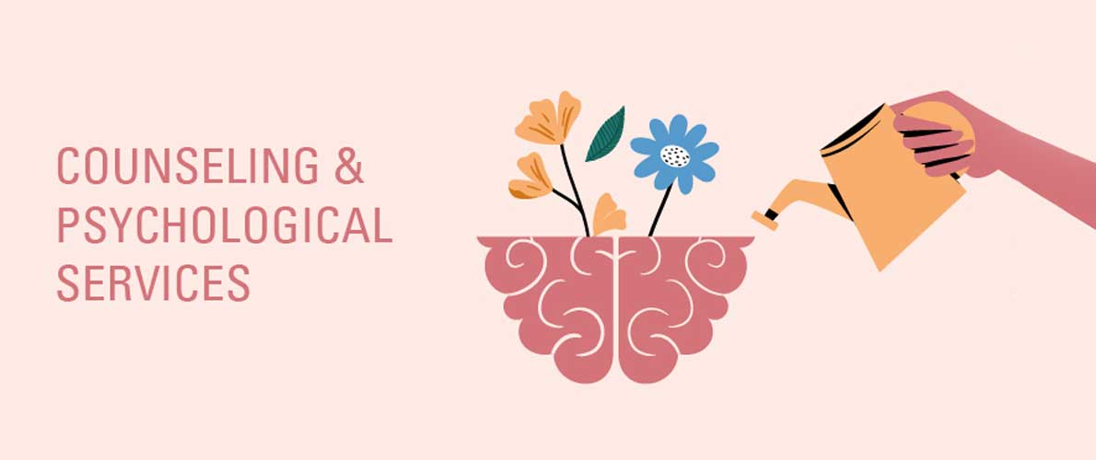
Learning Outcomes
The students will be able to understand the basics of counseling and how these can be helpful in their life.
Learn the difference between a psychologist, a psychiatrist, counseling & psychotherapy.

Slide 3
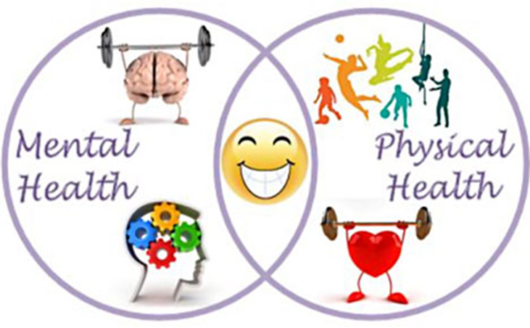
MENTAL HEALTH AND PHYSICAL HEALTH
Mental health is "a state of well-being in which the individual realizes his or her own abilities, can cope with the normal stresses of life, can work productively and fruitfully, and is able to make a contribution to his or her community“. (WHO)
Mental health includes our emotional, psychological, and social well-being.
It affects how we think, feel, and act. It also helps determine how we handle stress, relate to others, and make choices.
On the other hand, Physical health is the state of being free from illness or injury.

Slide 4
Physical health problems significantly increase our risk of developing mental
health problems, and vice versa.

Slide 5
DISCUSSION
WHAT ARE THE SIGNS AND SYMPTOMS OF SOMEOME GOING THROUG A MENTAL HEALTH PROBLEM?

Slide 6
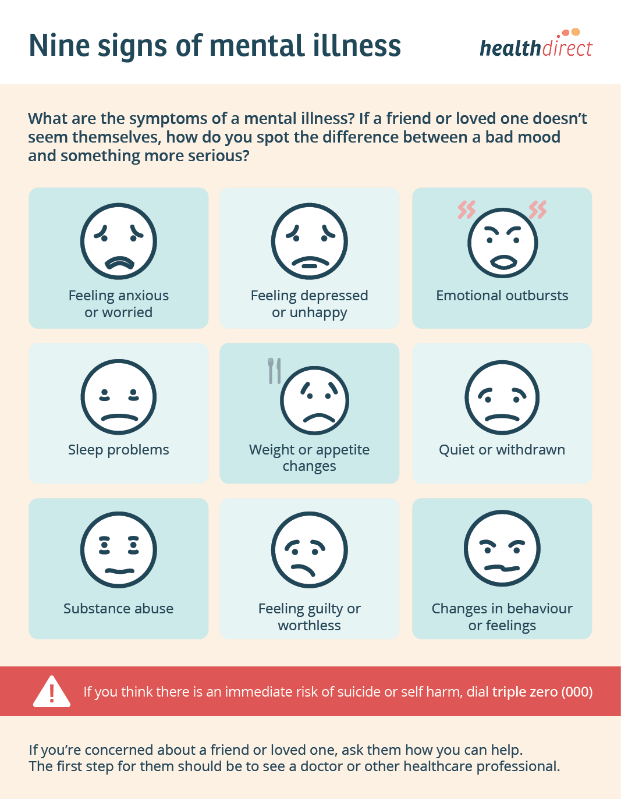
Some signs and symptoms of someone experiencing mental health problems.

Slide 7
MENTAL HEALTH DISORDERS
Mental disorders (or mental illnesses) are conditions that affect your thinking, feeling, mood, and behavior. They may be occasional or long-lasting (chronic).
They can affect your ability to relate to others and function each day.
Symptoms of illness include:
Changes in mood
Changes in person’s perception of reality
Changes in a person’s ability to organize or focus their thoughts.
Mental illness effects people’s feelings, thoughts and behavior, causes negative effects on people’s lives or the lives of their families.

Slide 8
What causes mental disorders?
There is no single cause for mental illness. A number of factors can contribute to risk for mental illness, such as:
Your genes and family history
Your life experiences, such as stress or a history of abuse, especially if they happen in childhood
Biological factors such as chemical imbalances in the brain
A traumatic brain Injury
A mother's exposure to viruses or toxic chemicals while pregnant
Use of Alcohol or recreational drugs
Having a serious medical condition like cancer
Having few friends, and feeling lonely or isolated
Mental disorders are not caused by character flaws. They have nothing to do with being lazy or weak.
Notes:
https://medlineplus.gov/mentaldisorders.html

Slide 9
How are mental disorders diagnosed?

Slide 10
The steps to getting a diagnosis include:
A medical history
A physical exam and possibly lab tests, if your provider thinks that other medical conditions could be causing your symptoms
A psychological evaluation. You will answer questions about your thinking, feelings, and behaviors.
Symptoms are causing serious problems in the ability to study, work or relate to others

Slide 11
1. What is the difference between a psychologist and a psychiatrist? 2. What is the difference counseling and therapy?
Discussion

Slide 12
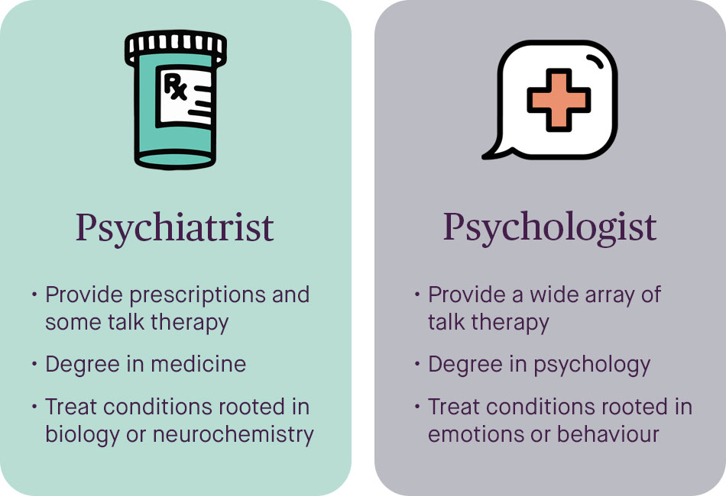
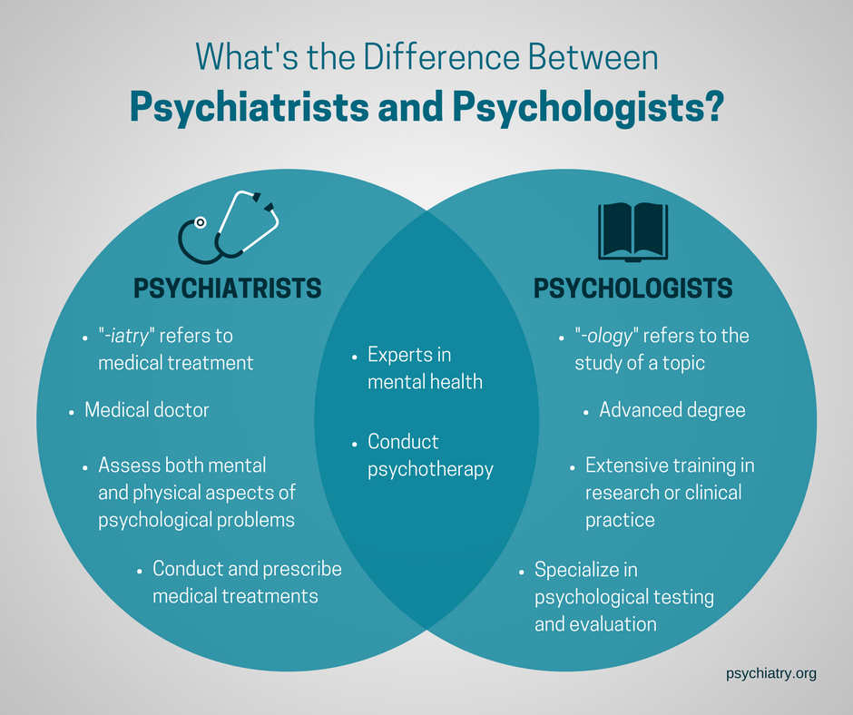

Slide 13
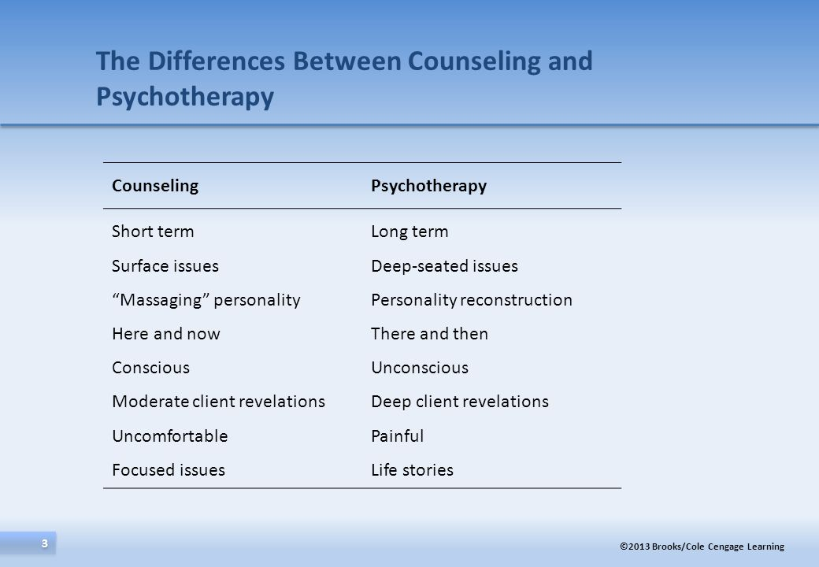

Slide 14
ACTIVITY
WHO HELPED YOU?
Close your eyes, think about a time when you were very unhappy, in your mind, choose a person who would you like to talk to, with whom you can share your pain with.
What qualities you would you want from that person?

Slide 15
You would probably choose someone who would accept your feelings, not try to give you advice.
Whom you could trust
Who would not interrupt you
Who would hold you emotionally and make you feel safe, even they could do nothing to change your difficult circumstances

Slide 16
Helper:
Helpers are generally responsible for the following:
(1) defining and maintaining a helping relationship;
(2) facilitating a helping alliance; and
(3) facilitating the client's movement toward some specific outcome.
Professional helper should be a teacher, a mentor, a motivator and a guide to assisting the person to find solutions to their life situations.
In contrast to friends, relatives and acquaintances, a counsellor has a more formal relationship with the client.

Slide 17
Qualities of the helper:
Keeping confidentiality
Empathy
Positive Regard
Being authentic
Being non judgmental

Slide 18
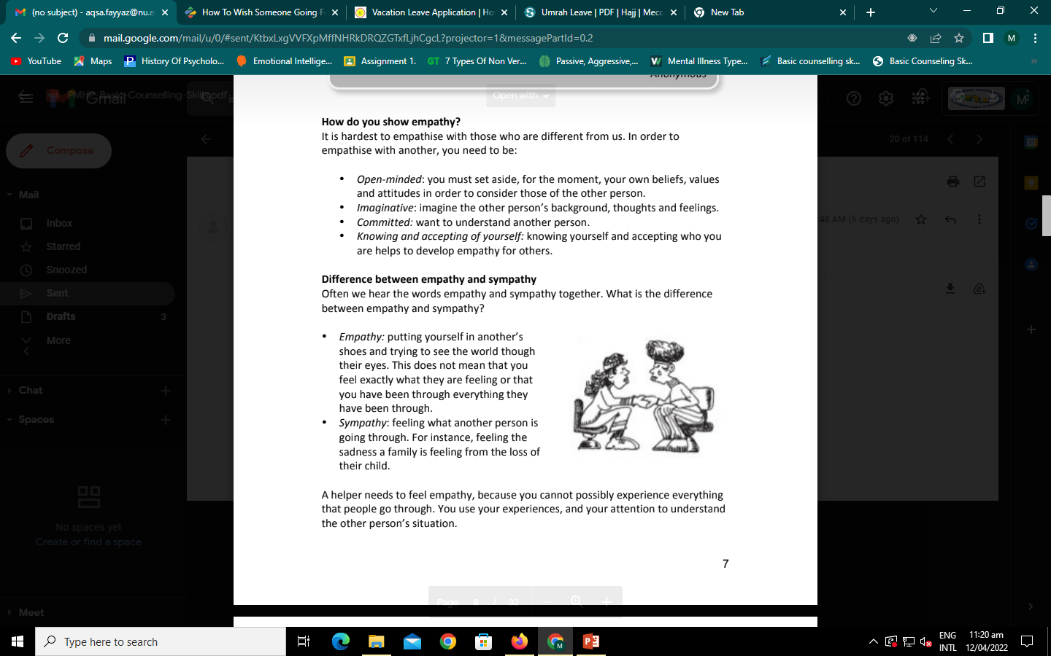
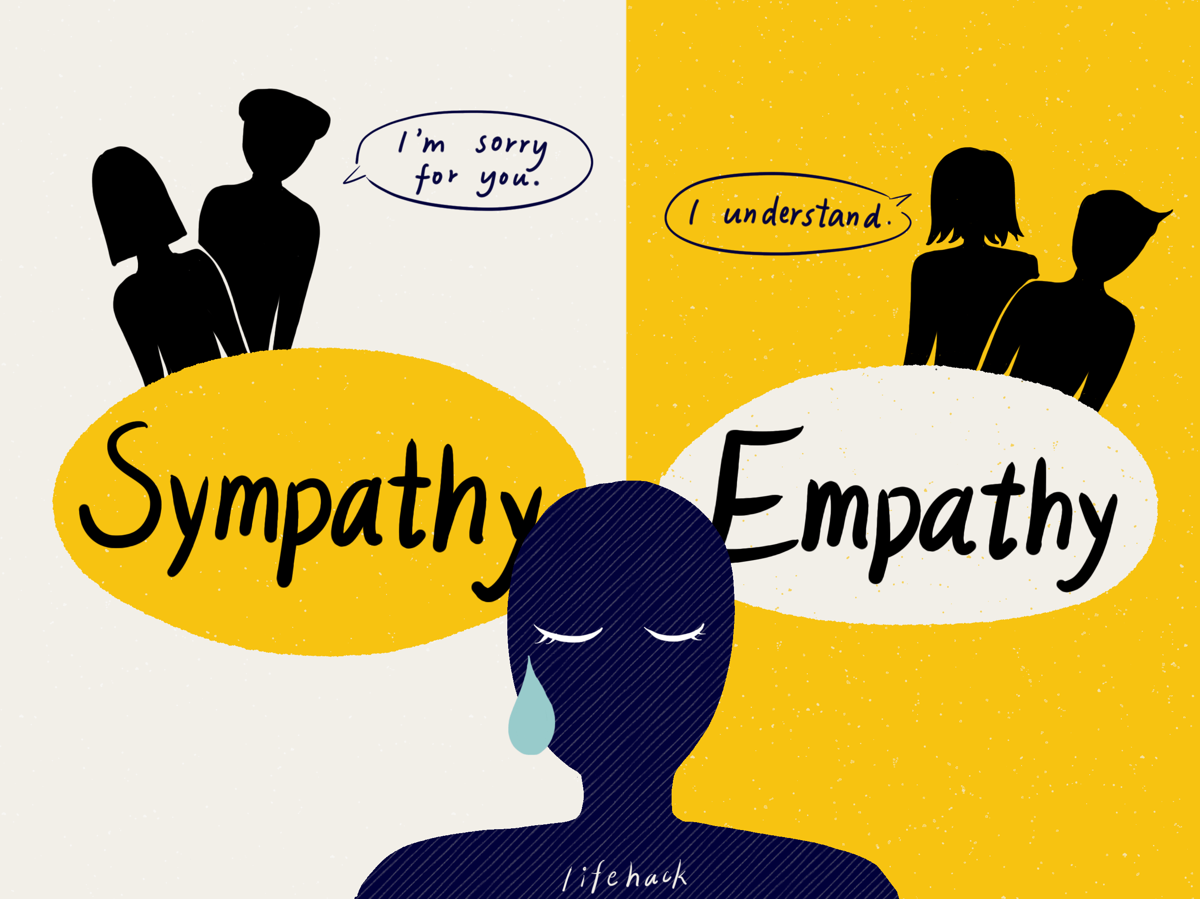

Slide 19
HOW TO COUNSEL A FRIEND?
Notes:
https://willamette.edu/offices/counseling/how-to-help-a-friend.html

Slide 20
How you can help someone going through a mental health problem.
Take the person aside and talk to them in private.
Be honest and direct, but avoid labeling your friend. Share what you have observed and why it concerns you without using psychological terms. For example, you might say: "I've noticed that you've been missing class a lot lately and you aren't answering your phone or text messages like you used to. I'm worried about you. What can I do to help?
Make a referral.
Follow up. Let the person know that you'll be checking back with him or her later to see how things turned out.
.

Slide 21
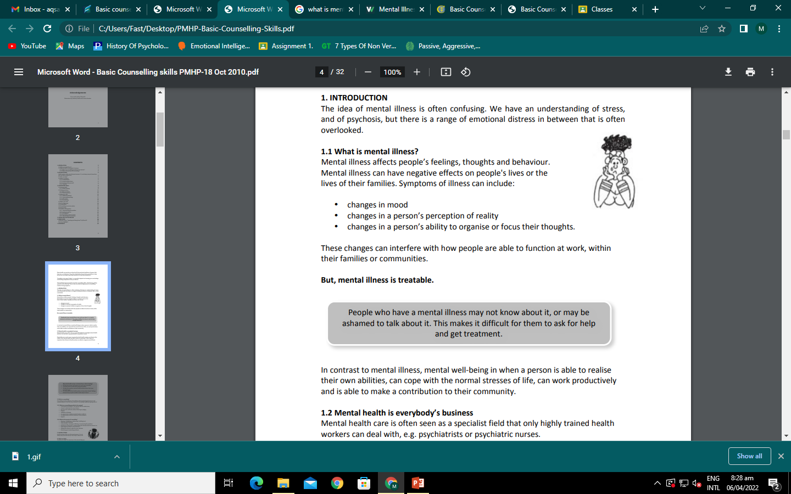
Mental illness is treatable

Slide 22
Thank you.

